Slide 1
A Reduced Order Model for a TOV Study in a Solar PV Project
Hoba Abdullah
Electric Power Engineers, Inc
Austin, TX 78738

Slide 2
Contents
Aim & motivation
Detailed system model
Inverter benchmark tests
Equivalencing methodology
TOV scenarios
Results

Slide 3
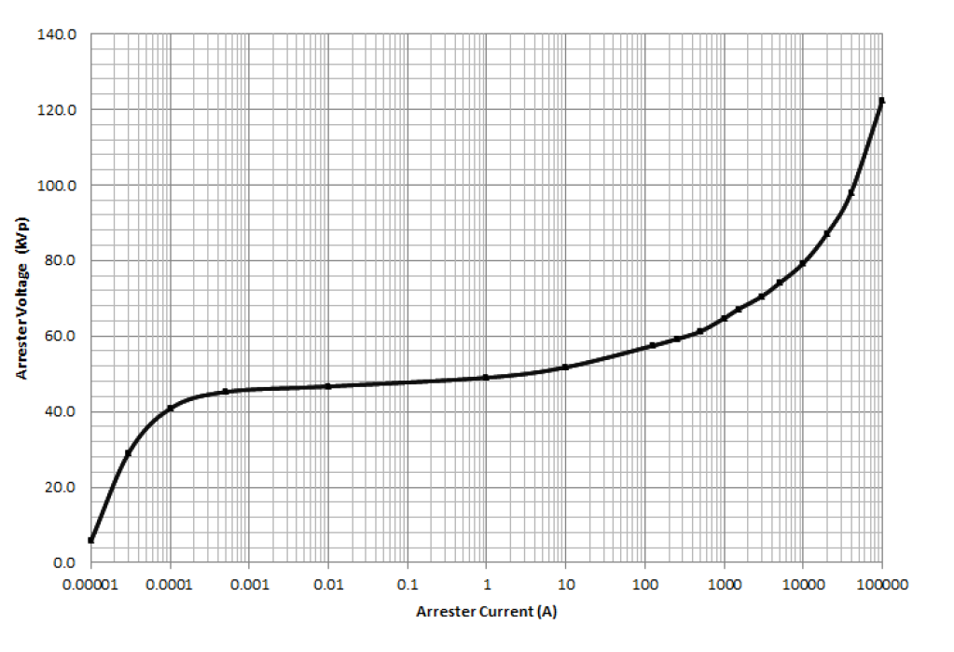
Aim & motivation
The main aim is to assess surge arrester capability within a substation
To assess surge arresters, various scenarios need to be performed (load rejection, capacitor switching, faults, …etc.)
This requires that we are able to build an EMT model at the substation MV level
Most, if not all, methods in literature equivalence renewable projects at POI HV level not substation MV level
Extremely long simulation times because of large number of inverters (switches) in renewable projects
The number of switches in EMT model must be reduced for faster simulations

Slide 4
Detailed System Model
80 MW solar PV project
45 inverters, each is capable of producing 1.8 MVA
Each inverter block has a DC to AC stage, an LC filter and an inverter step up transformer (ISU) transformer
Surge Arresters exist at the beginning of each feeder inside the substation
Surge arresters are MOV with MCOV of 24.4 kV and an energy handling capability of 219 kJ
Project connects to POI at 138 kV thorough the MPT which has a rating of 89 MVA
Feeder breakers have grounding switches interlocked that ground feeder within 1 cycle

Slide 5

Inverter Benchmark Tests
Inverter response is fundamentally different from conventional synchronous machine
For ungrounded synchronous machines, a single line to ground fault can cause the phase to ground voltage to increase by a factor of $\sqrt{3}$

Slide 6
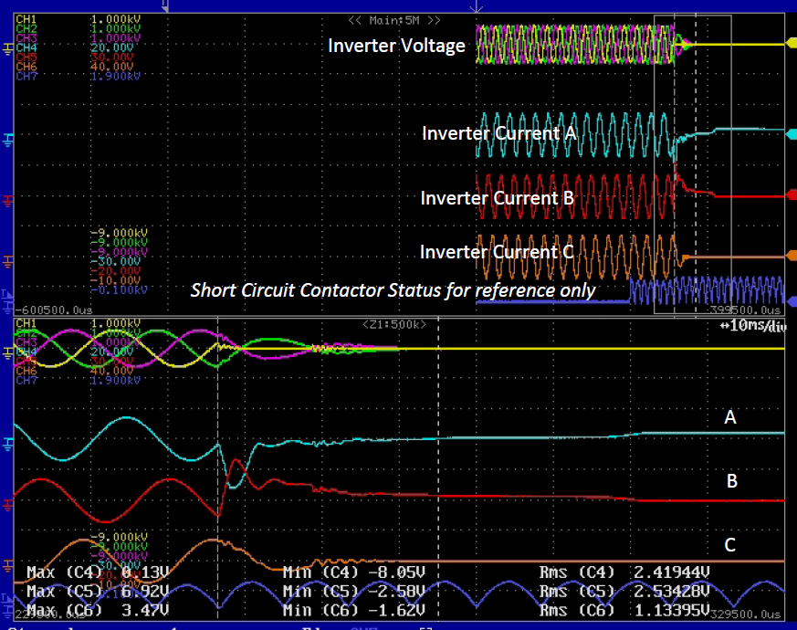
Inverter Phase A to Phase B fault

Slide 7
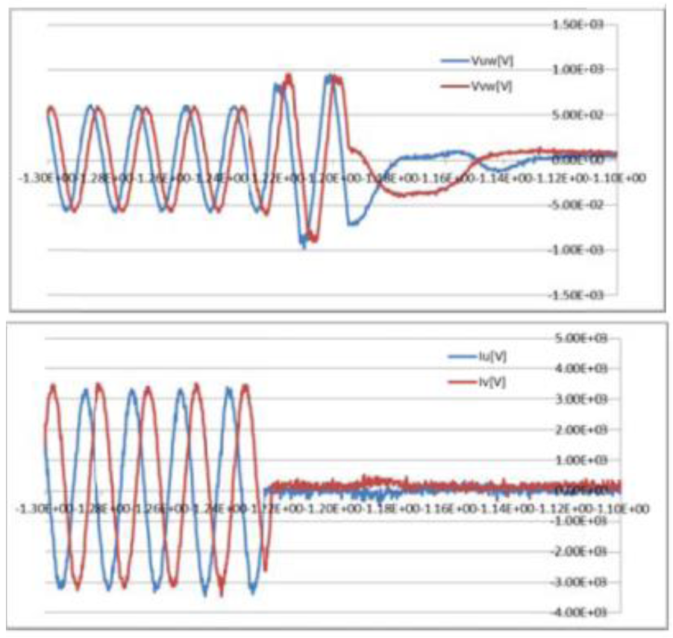
Inverter load rejection test

Slide 8
Equivalencing methodology
We call it “Pseudo-Norton's Equivalent”
Each feeder by a pseudo-Norton's equivalent
Consists of two parts:
Pseudo-Norton's Source
Pseudo-Norton's Parallel Impedance
The pseudo-Norton's source will be responsible for equivalencing the low frequency response of the feeder
Pseudo-Norton's Parallel Impedance will be equivalencing the high frequency response of the feeder
This means that the step response of the pseudo-Norton's source should correspond to the low frequency response portion of the overall feeder frequency response
This also means that the step response of the impedance in parallel should correspond to the high frequency response portion of the overall feeder frequency response.

Slide 9
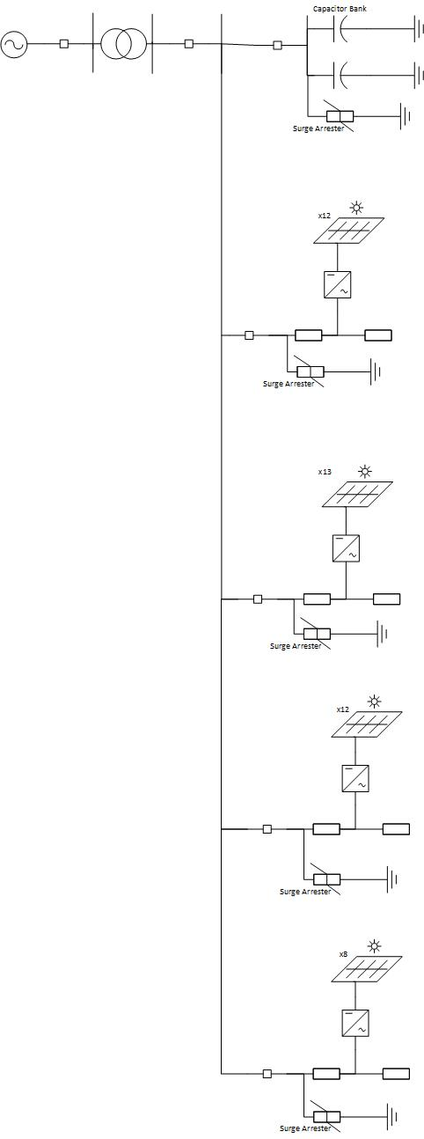
Equivalencing methodology (cont.)
Transformation
Detailed System Model
Reduced System Model

Slide 10
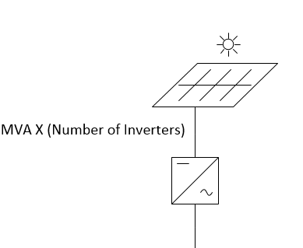
Pseudo-Norton's Source
Scale one inverter to represent all inverters on the feeder
Inverter MVA rating must be scaled up by a factor equal to the total number of inverters on the feeder
The controls of the inverter are to kept the same without any change as long as per unit is incorporated
The values of the inductance and the capacitance of LC filter are also to be scaled up by the number of inverters ( L divided by number of inverters, C multiplied by number of inverters)
ISU transformer MVA rating is also to be scaled up by a factor equal to the number of inverters without changing its per unit impedance

Slide 11
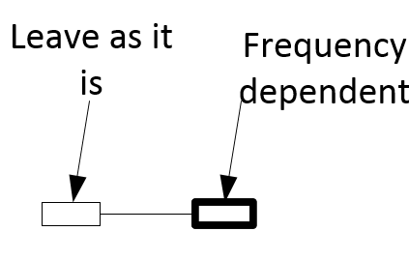
Pseudo-Norton's Parallel Impedance
Frequency dependent impedance that captures the high frequency response of the cable sections in collector feeder
Two options:
Perform a frequency scan on the feeder with all inverters removed from the project (ISU transformers have to be open-circuited as well as the feeder breaker). Using that frequency scan, the user can use vector fitting to construct a frequency dependent model. Passivity has to be enforced upon the resulting fitting by insuring that negative resistance is not a result of the fitting. Negative resistance causes instability in the EMT simulations
Keep the feeder intact without performing a vector fitting. This means that the cable sections are to be kept in the model but without the inverters, LC filters or the ISU transformers
The first cable section has to be removed from this frequency dependent impedance

Slide 12
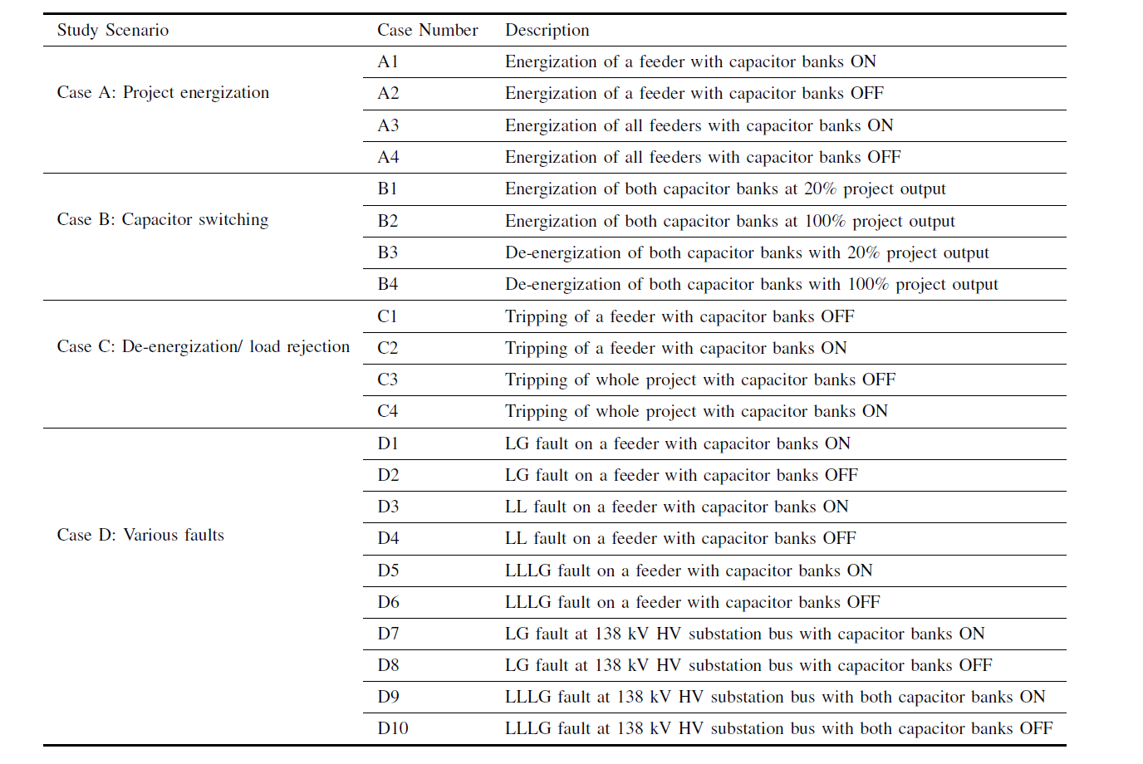
TOV scenarios

Slide 13
Results

Slide 14
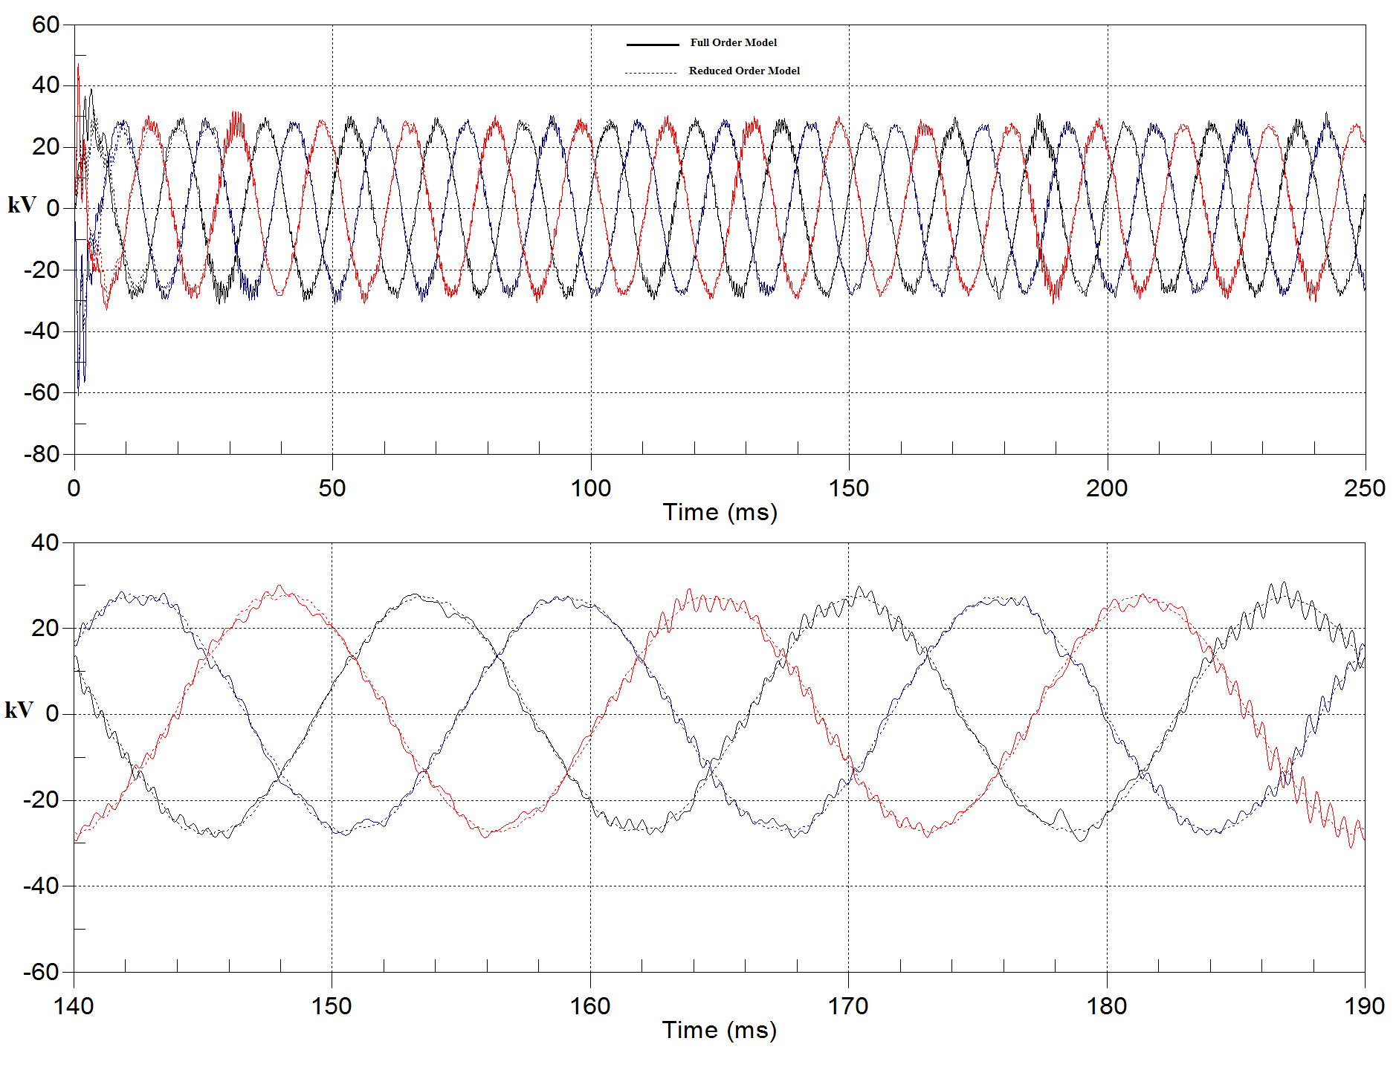
34.5 kV bus three phase voltages for capacitor bank energization

Slide 15
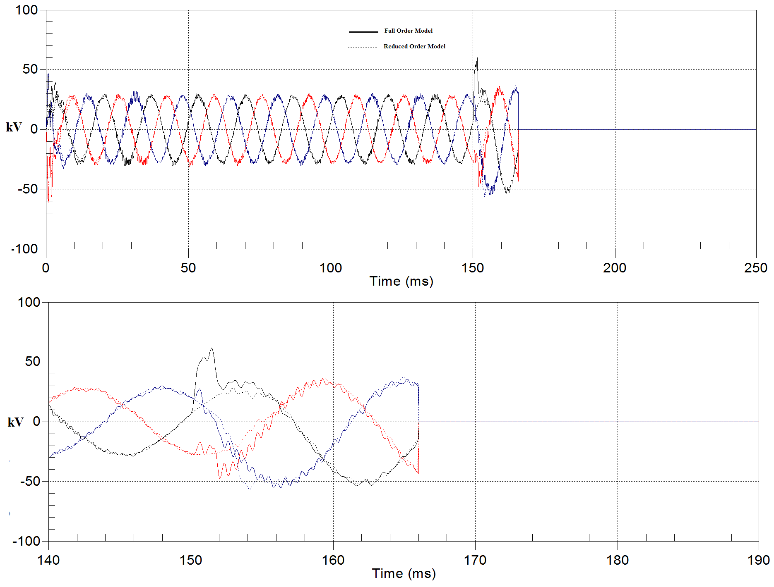
34.5 kV bus three phase voltages for feeder 1 tripping with capacitor banks OFF

Slide 16
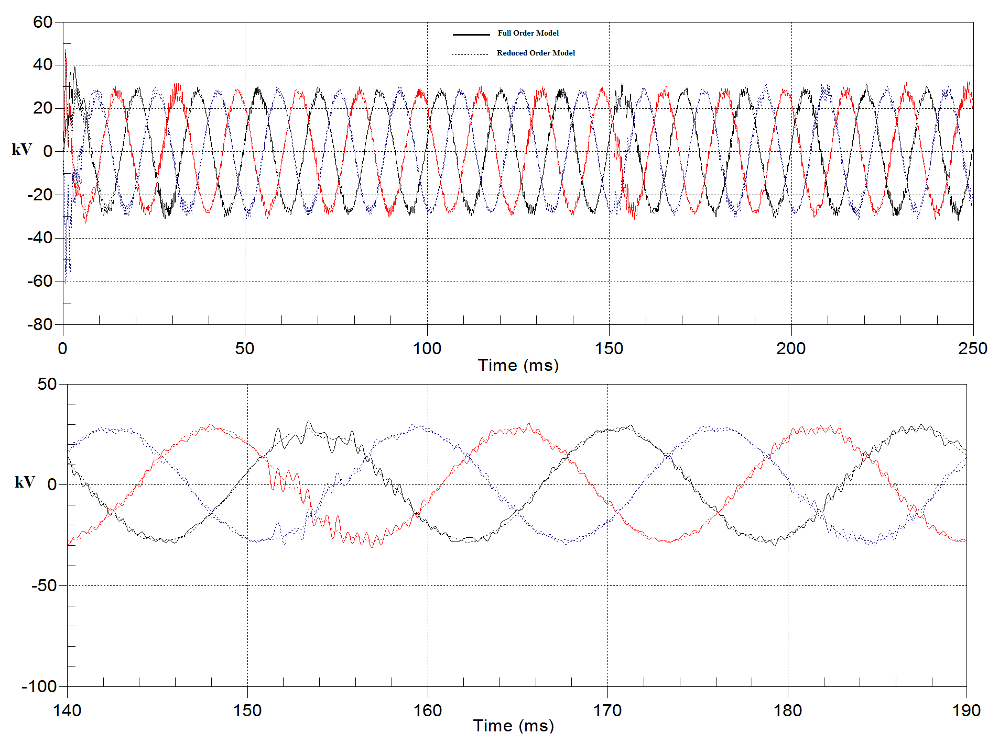
34.5 kV bus three phase voltages for feeder 1 tripping with capacitor banks ON

Slide 17
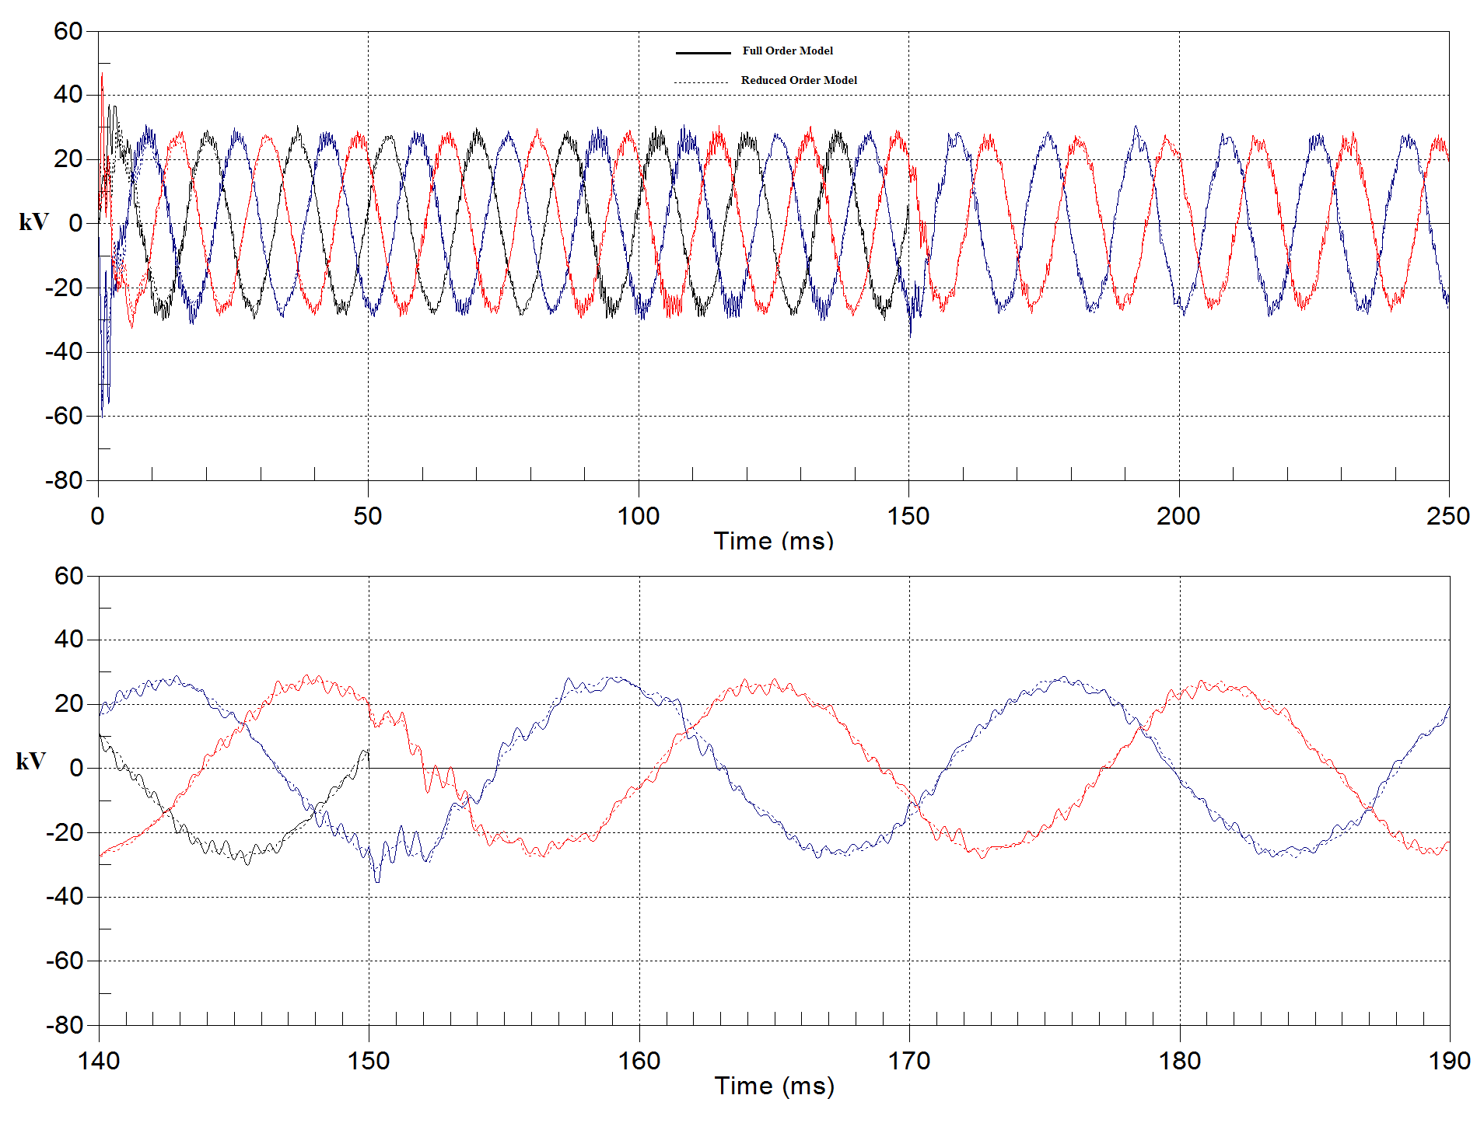
34.5 kV bus three phase voltages for LG fault and capacitor banks OFF

Slide 18
Thank You!
Questions?

